Slide 1
Title:
Sales Analytics Dashboard – Superstore Dataset
Subtitle:
Task 4 – Data Analyst Internship
By:
Tashefa Naeem Shaikh 18 Nov 2025
Created using Power BI | Dataset: Superstore (Kaggle)

Slide 2
Objective
To design an interactive and insightful Power BI dashboard to help business stakeholders analyze:
Sales performance
Profitability
Product category insights
Time-based trends
Forecasting indicators
Outcome:
Learn how to create dashboards that inform business decisions.
Tools Used:
Power BI
Superstore Dataset (Kaggle)

Slide 3
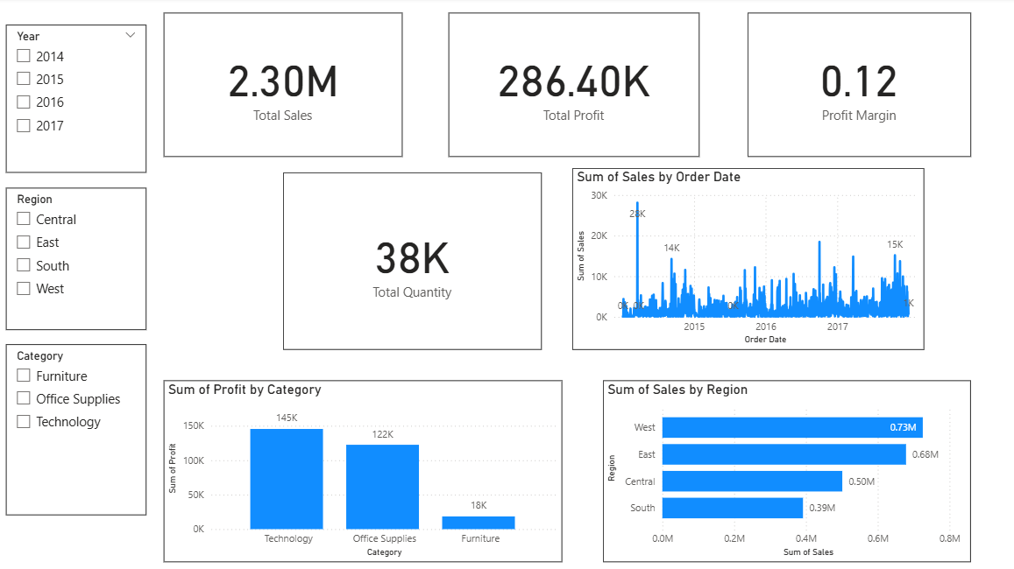
PAGE 1: EXECUTIVE SUMMARY
High-level performance indicators
Key Elements:
Total Sales
Total Profit
Profit Margin
Total Orders
Trend of Sales Over Time
Category & Regional analysis
Slicers for interactivity
Top Insights from Executive Summary
Technology category generated the highest sales.
West region showed the strongest performance in revenue.
Overall profit margin is strong but varies by category.
Sales show a growing trend in certain months (seasonality).
Some segments contribute more revenue though having fewer orders.

Slide 4
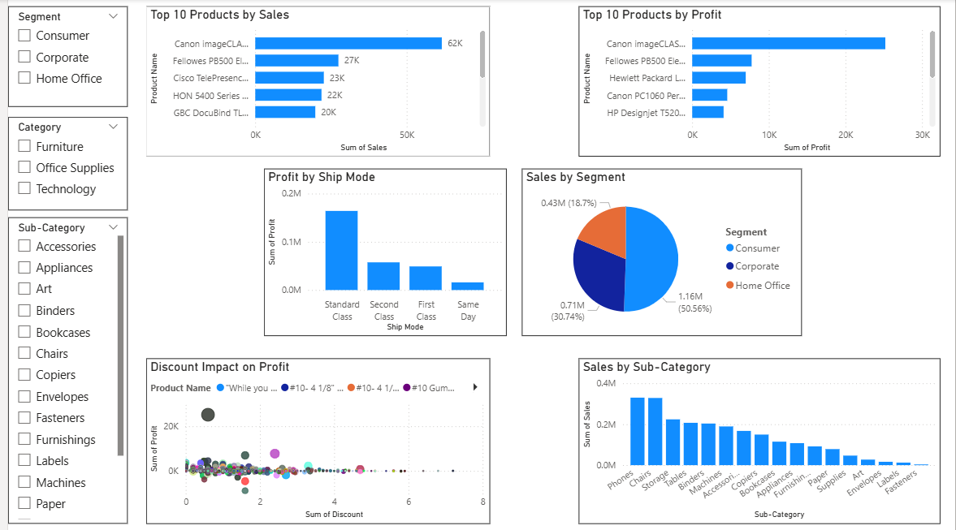
PAGE 2: PRODUCT PERFORMANCE
Detailed analysis of products & categories
Key Elements:
Top 10 products by Sales
Top 10 products by Profit
Sales by Sub-Category
Discount vs Profit (Scatter Plot)
Sales by Segment
Profit by Ship Mode
Slicers: Segment, Category, Sub-Category
Key Insights from Product Performance
Top 10 products contribute a large portion of sales revenue.
Some products generate high sales but low profit due to discounting.
Sub-Category: Phones, Chairs, Storage have highest sales.
Scatter plot shows that higher discounts reduce profit significantly.
Consumer segment dominates in both sales and order volume.
Standard Class shipping mode is widely used and profitable.

Slide 5
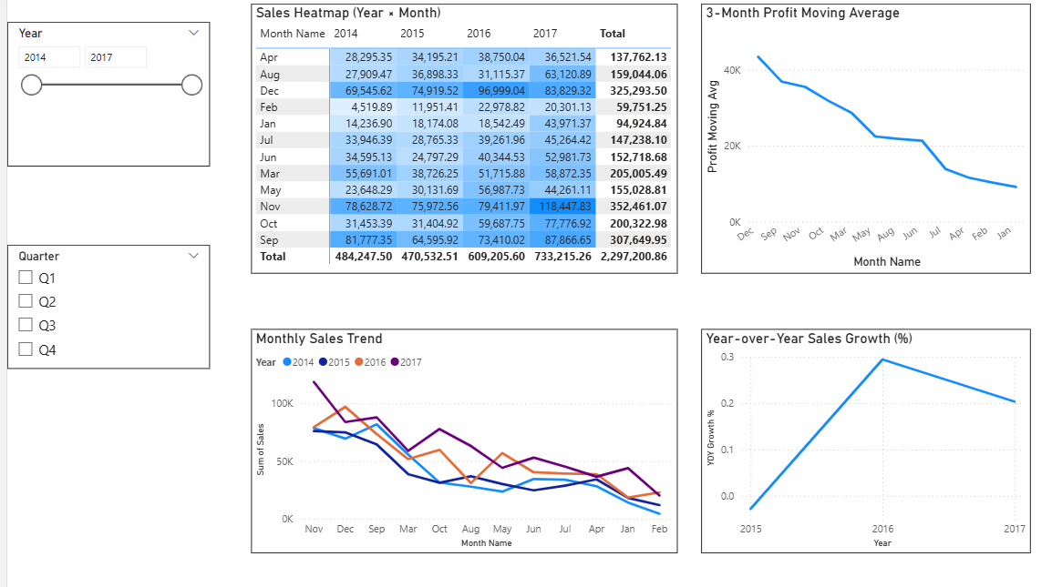
PAGE 3: TIME & FORECASTING
Trend analysis, YOY growth, moving averages
Key Elements:
Monthly Sales Trend
YOY Growth %
Sales Heatmap (Year × Month)
Profit Moving Average
Forecasting Line (Power BI Analytics Pane)
Slicers: Year, Quarter
Key Insights from Time & Forecasting
Monthly sales show clear seasonal patterns across years.
YOY Growth indicates positive improvement in 2015 & 2016.
Heatmap highlights peak sales months like November & December.
3-month moving average smooths fluctuations and shows stable upward trend.
Forecast suggests continued growth based on historical patterns.

Slide 6
Summary
This Power BI dashboard enables stakeholders to:
Monitor overall business performance
Evaluate product-level profitability
Understand yearly & monthly sales trends
Forecast future revenue patterns
Make informed decisions using interactive visuals
Thank You!

